Slide 1
Praise the Lord in all circumstances of your life

Slide 2
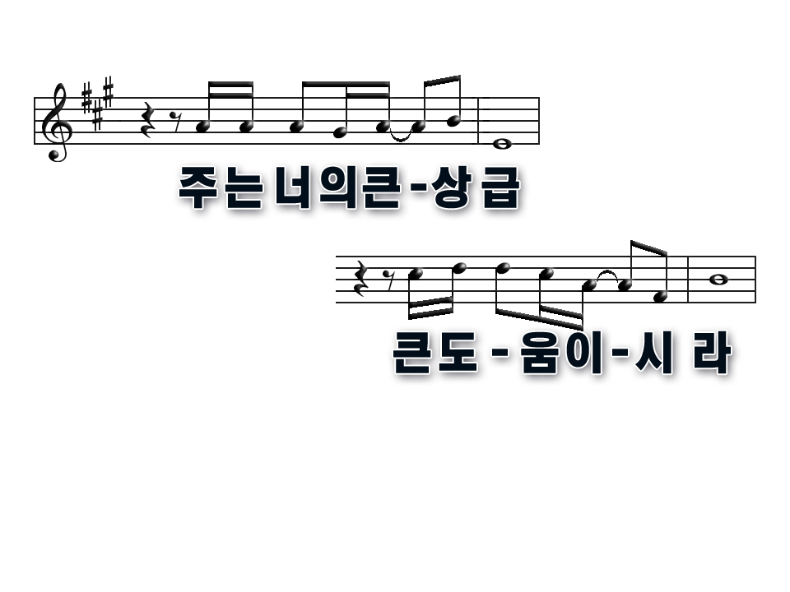
For he’s your great reward, the strong help in trouble

Slide 3
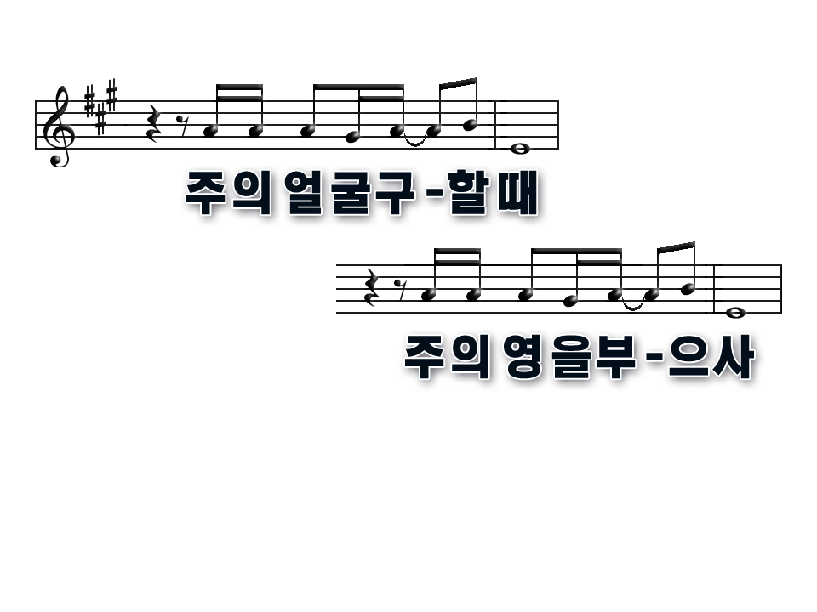
Lord, pour your spirit on us as we seek your face

Slide 4
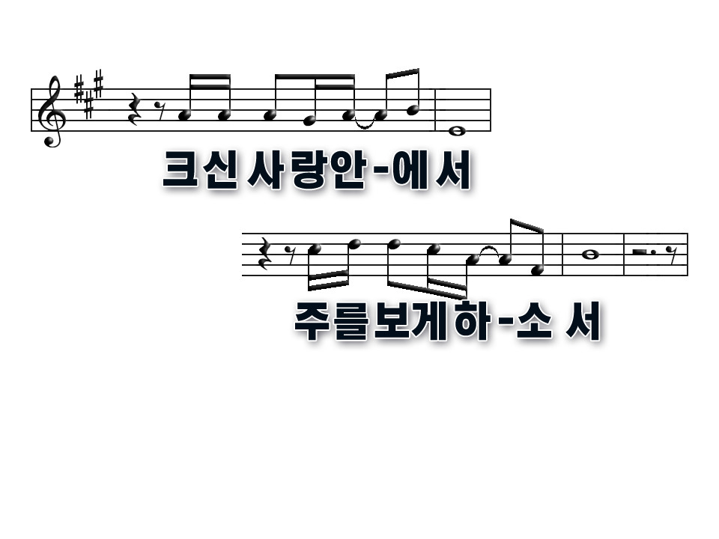
That we might be able to see you in your love

Slide 5
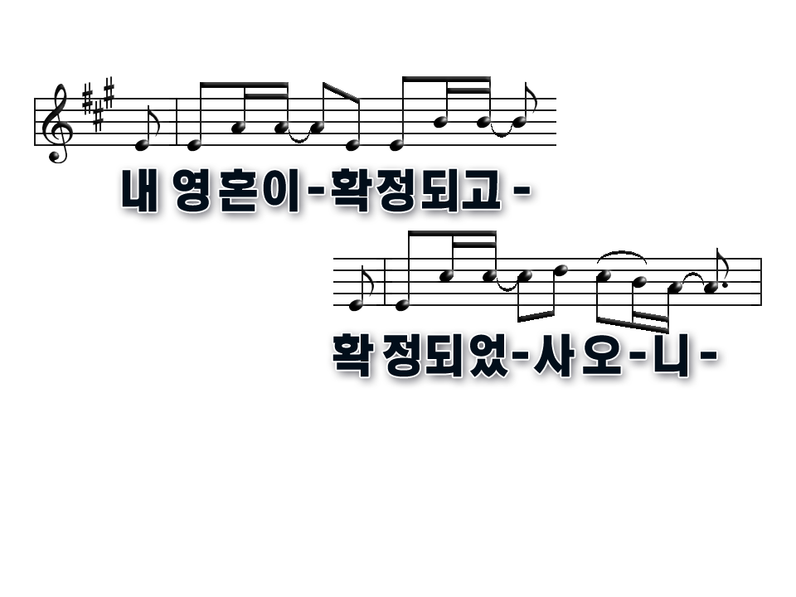
Lord, my heart is steadfast,
I will sing praises with my soul

Slide 6
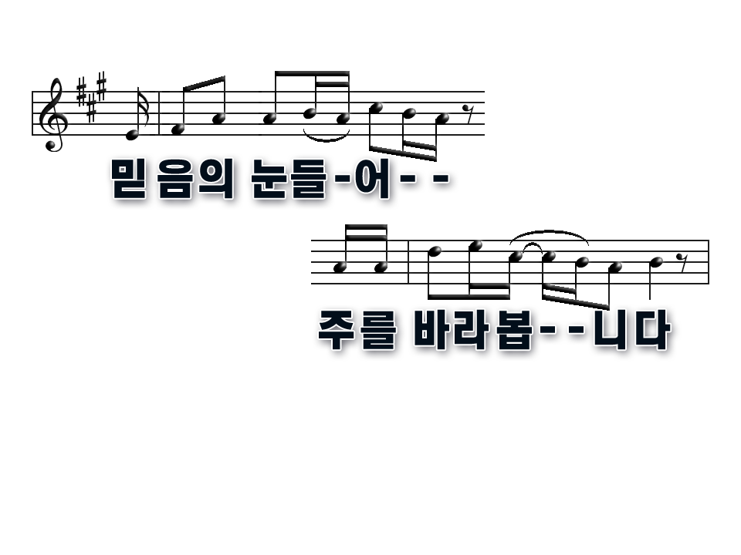
By faith Lord in all circumstances you may live

Slide 7
Praise the Lord in all circumstances of your life

Slide 8
For he’s your great reward, the strong help in trouble

Slide 9
Lord, pour your spirit on us as we seek your face

Slide 10
That we might be able to see you in your love

Slide 11
Lord, my heart is steadfast,
I will sing praises with my soul

Slide 12
By faith Lord in all circumstances you may live

Slide 13
The Lord is enthroned upon the praises of his people

Slide 14
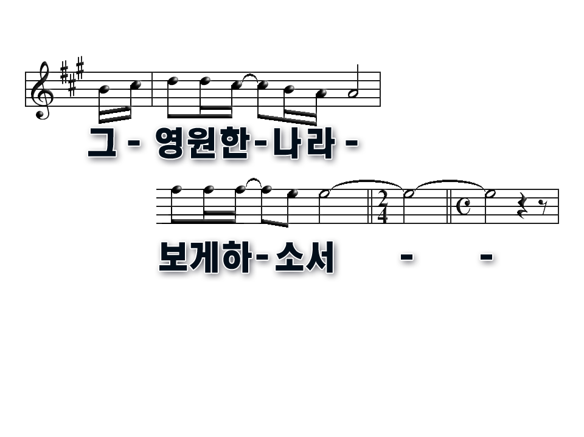
I long to see, my Lord, Your eternal kingdom

Slide 15
Lord, my heart is steadfast,
I will sing praises with my soul

Slide 16
By faith Lord in all circumstances you may live

Slide 17
Lord, my heart is steadfast,
I will sing praises with my soul

Slide 18
By faith Lord in all circumstances you may live

