Slide 1
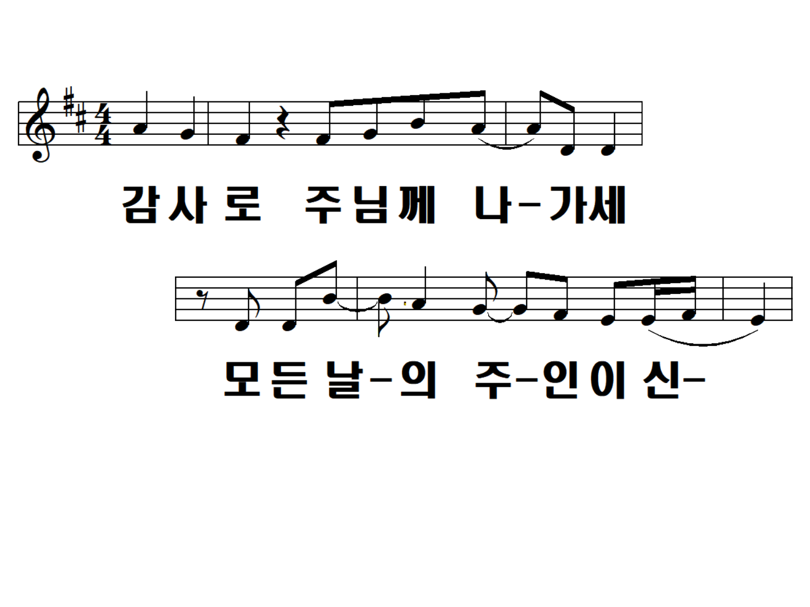
Go out to the Lord as a thank you The master of every day

Slide 2
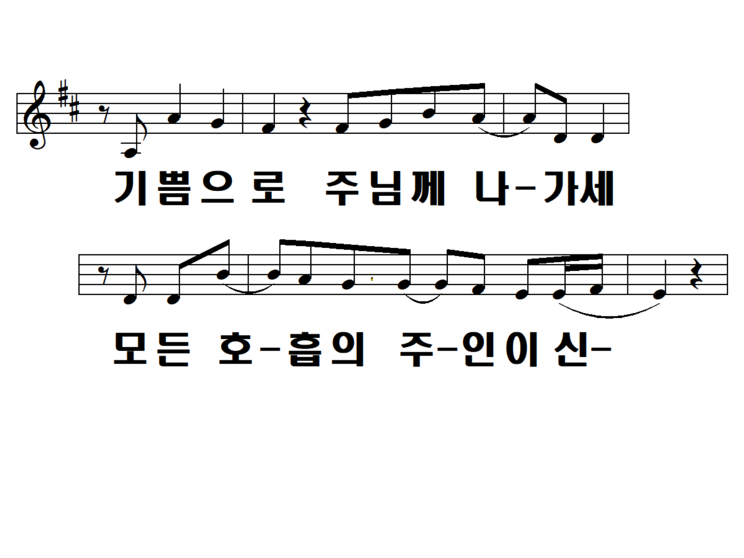
Go out to the Lord with joy
The master of all the breathing

Slide 3
Go out to the Lord as a thank you The master of every day

Slide 4
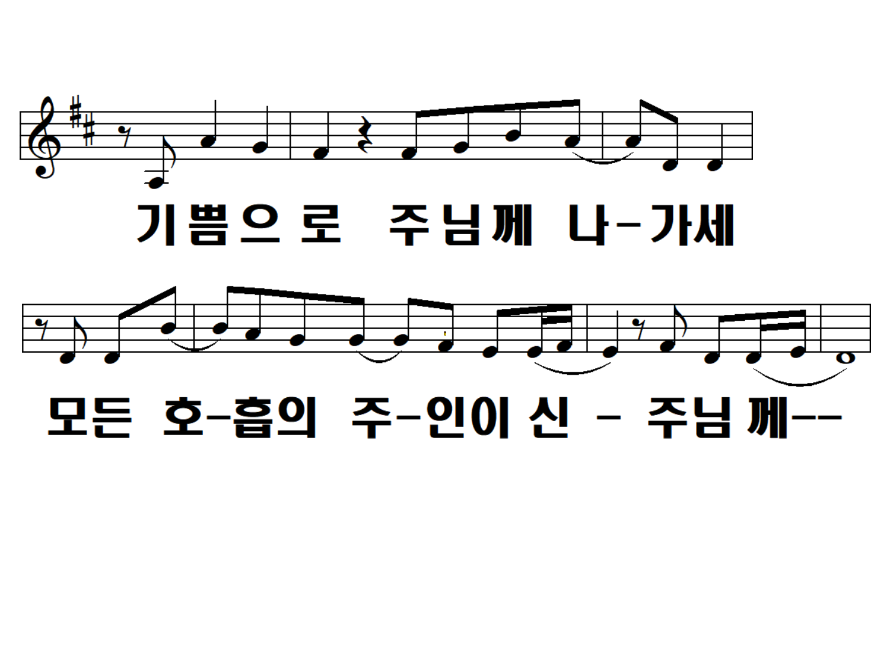
Go out to the Lord with joy
To the Lord,
the master of all the breathing

Slide 5
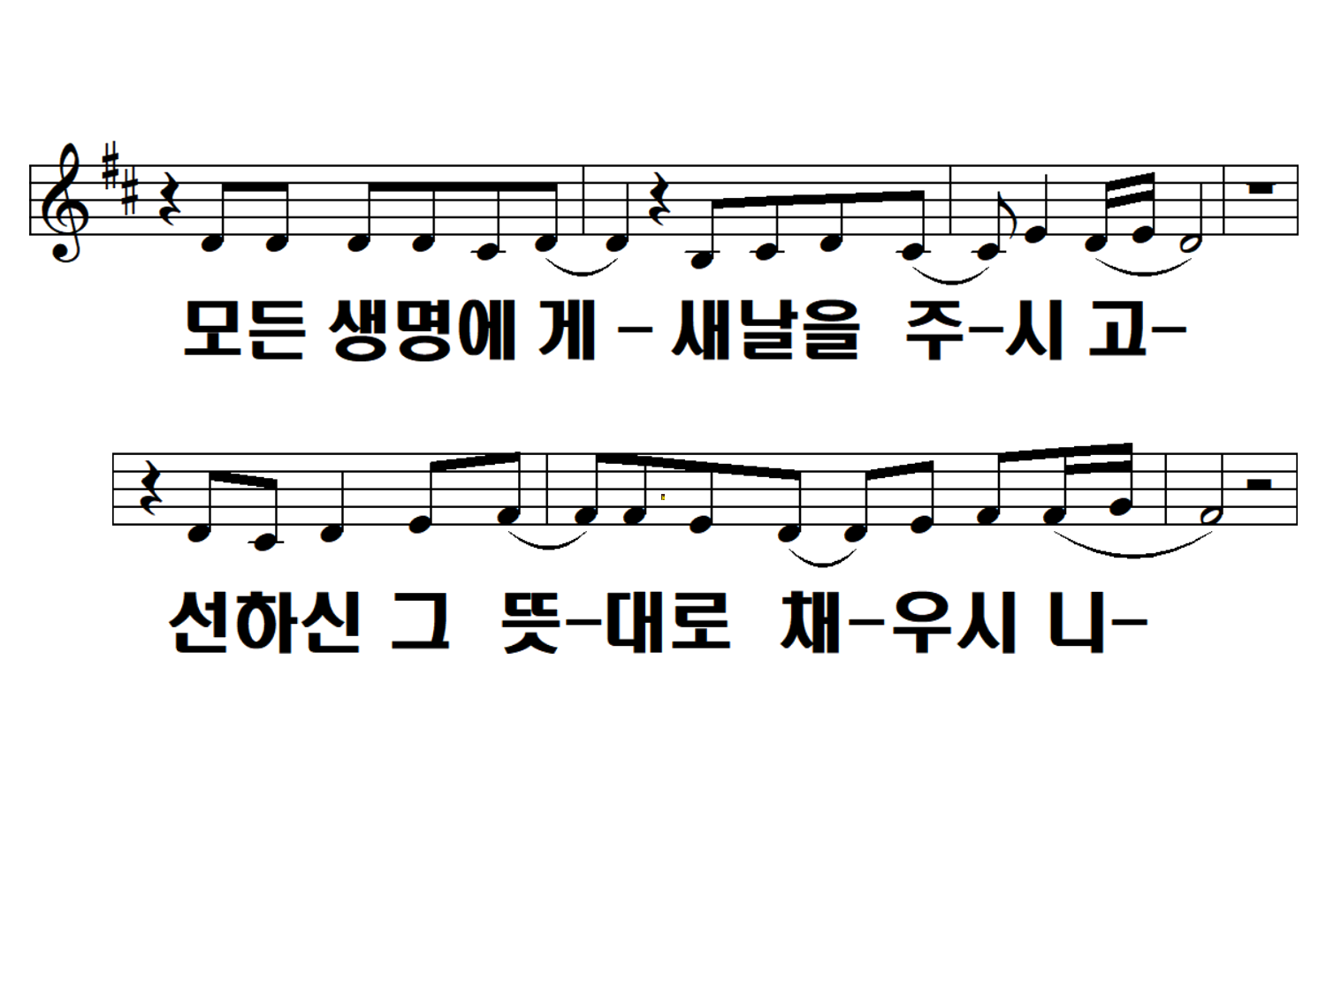
Give all life a new day You fill it up
according to the good will

Slide 6
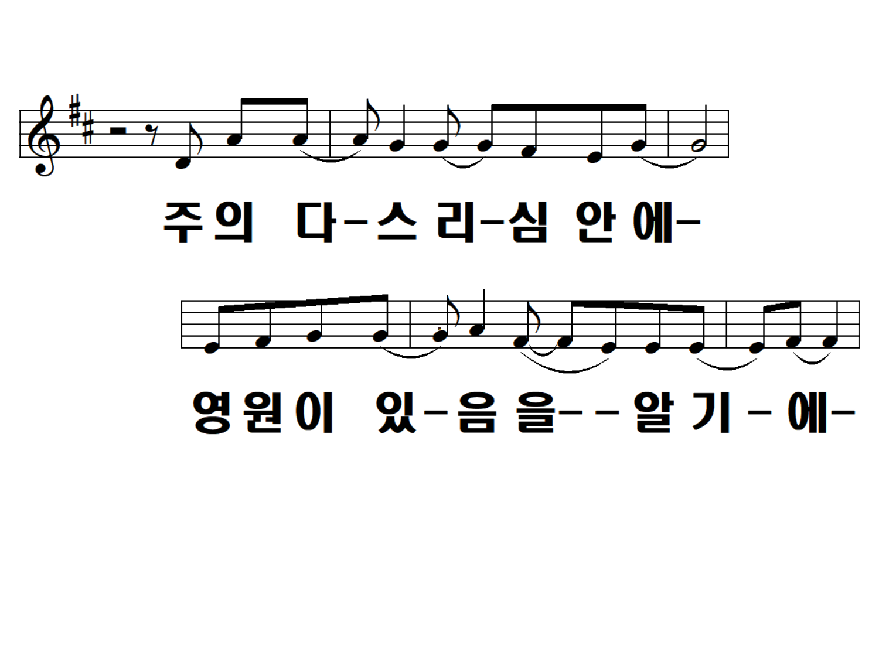
In the heart of the Lord I know there's forever

Slide 7
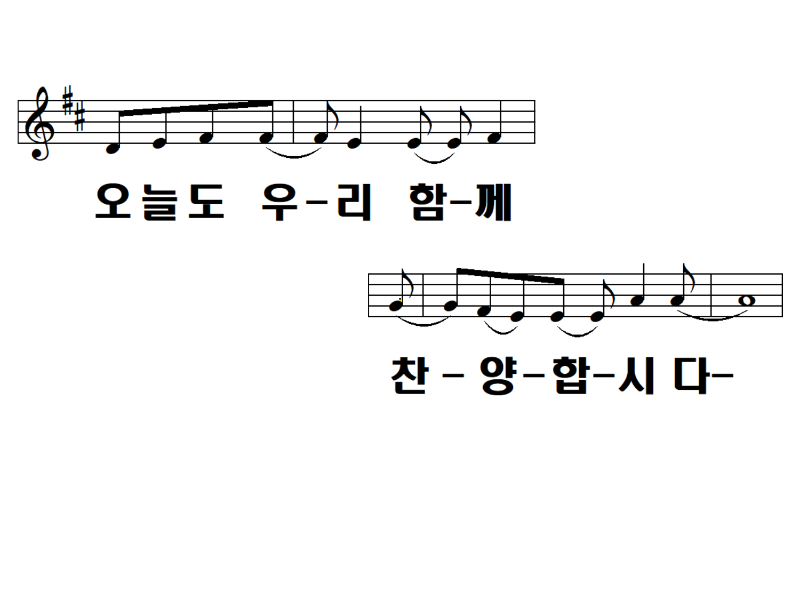
Let's be together again today. Let's praise him

Slide 8
Go out to the Lord as a thank you The master of every day

Slide 9
Go out to the Lord with joy
The master of all the breathing

Slide 10
Go out to the Lord as a thank you The master of every day

Slide 11
Go out to the Lord with joy
To the Lord,
the master of all the breathing

Slide 12
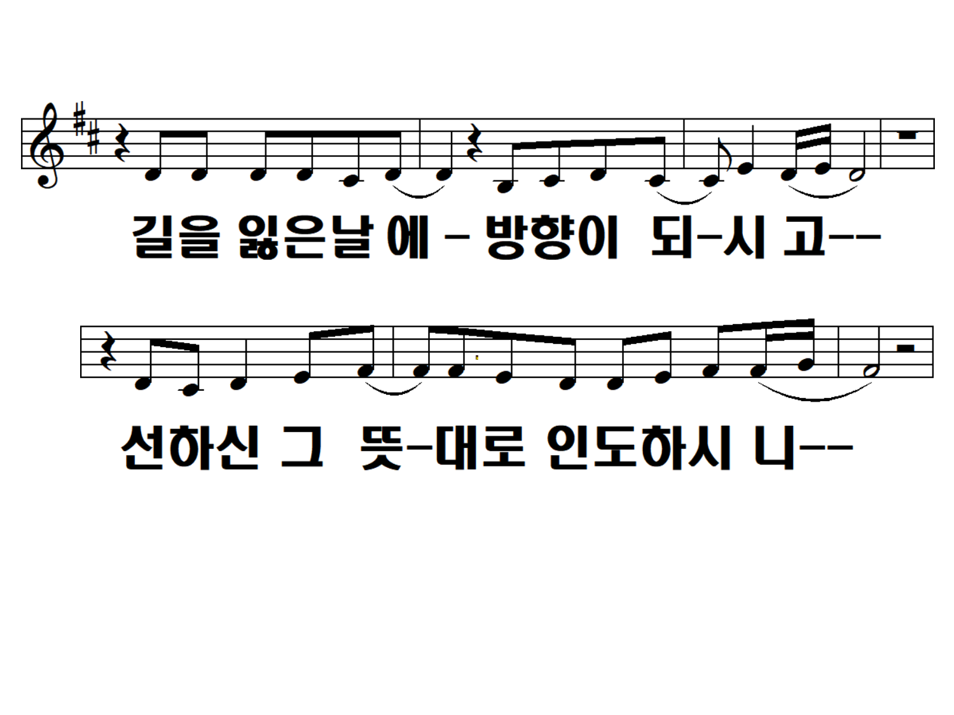
On the day you get lost, you become a direction. He will guide you according to the will of the good

Slide 13
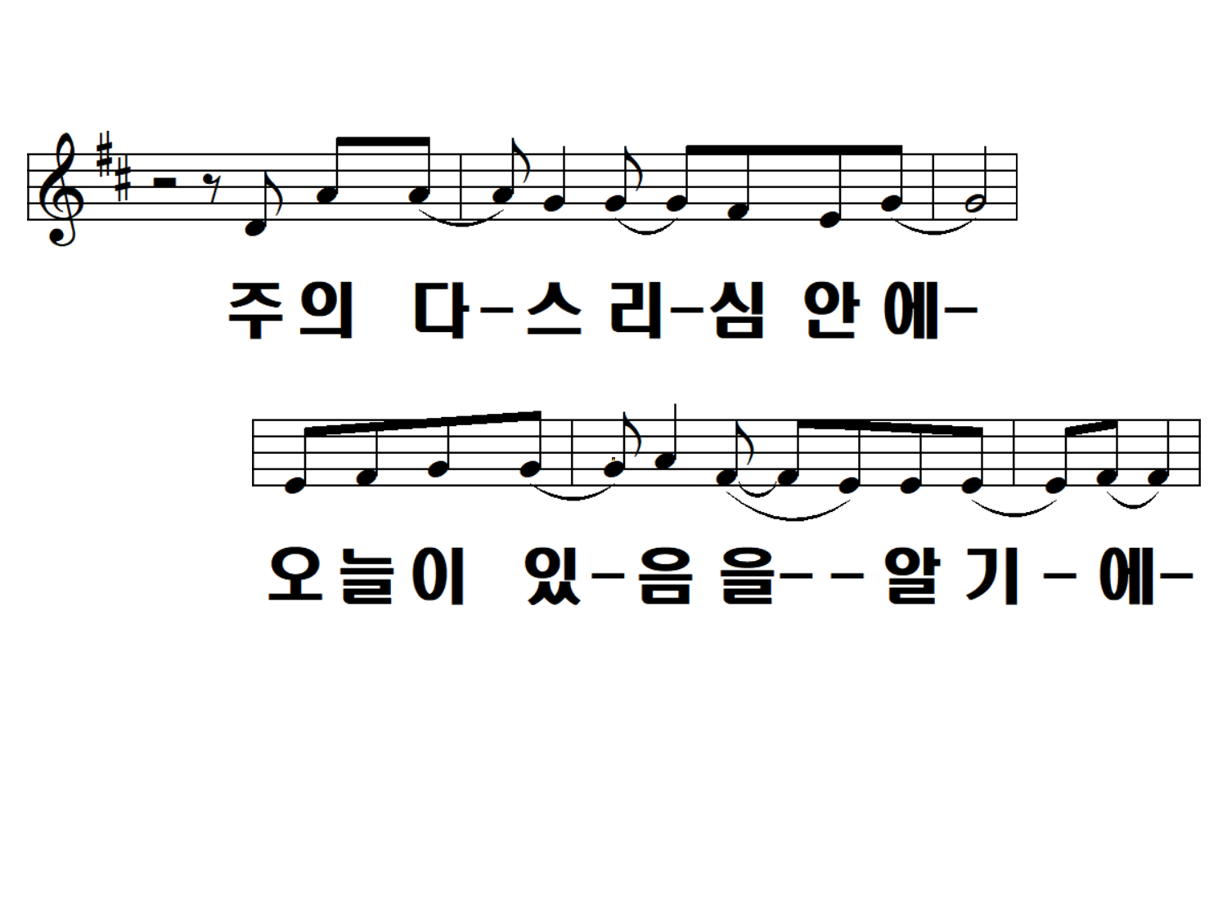
In the heart of the Lord knowing that there is today

Slide 14
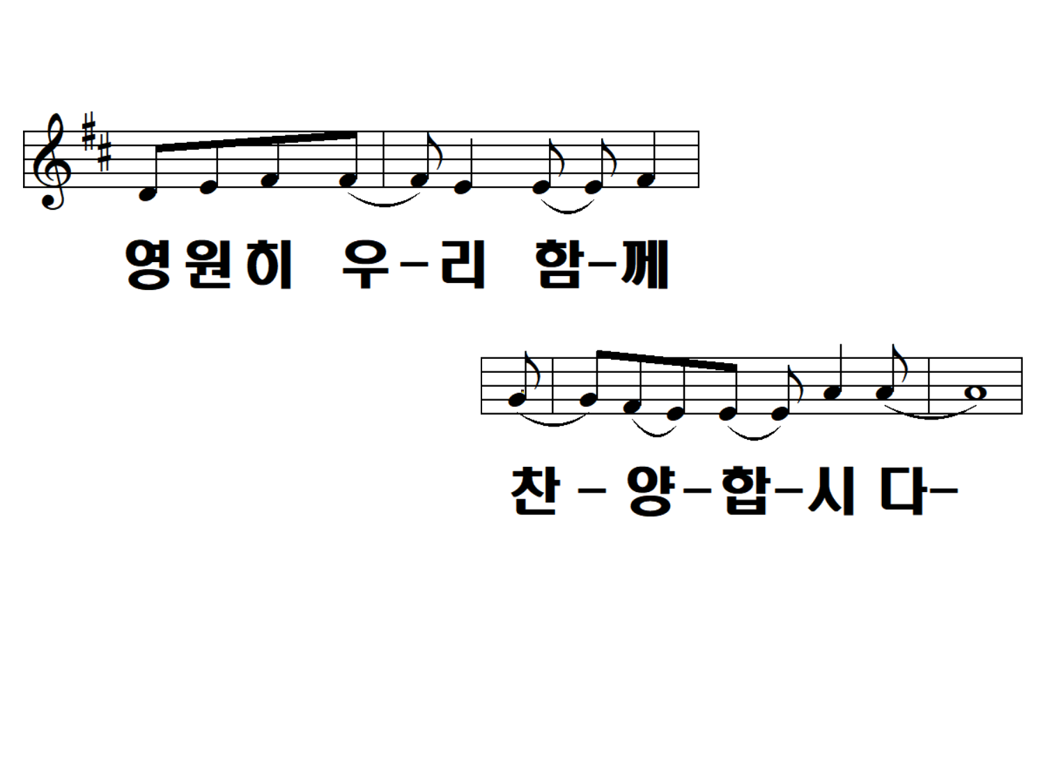
Let's be together forever Let's praise him

Slide 15
Go out to the Lord as a thank you The master of every day

Slide 16
Go out to the Lord with joy
The master of all the breathing

Slide 17
Go out to the Lord as a thank you The master of every day

Slide 18
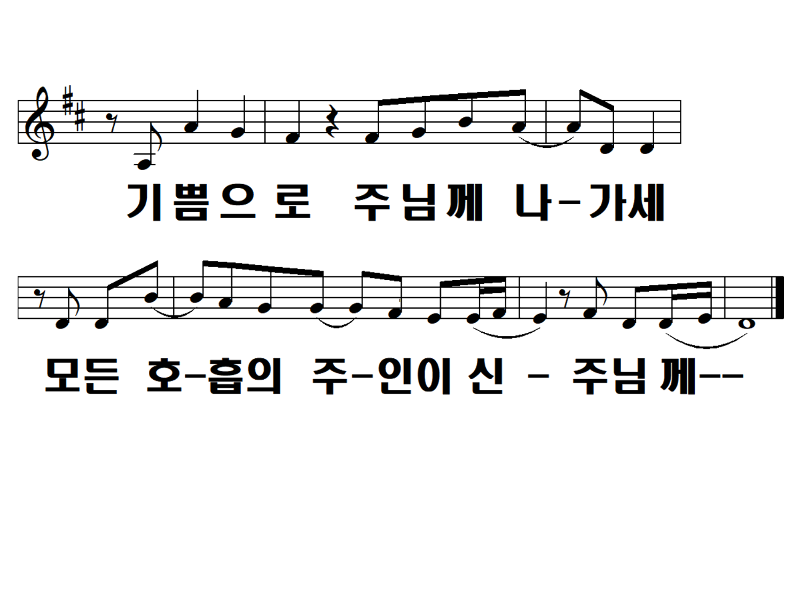
Go out to the Lord with joy
To the Lord,
the master of all the breathing

